Slide 1
To Establish Baseline for Threat Detection
Taruchit Goyal
2022DC04496
Mid-term dissertation evaluation

Slide 2
Cybersecurity use cases which align with work of current employer
Classification of email as spam and non-spam, phishing and non-phishing.
Analyzing Indicators of Compromise (IOCs) for intrusion detection system.
Identifying potential threats in network traffic.
UEBA for anomaly detection
Inadvertent Data Disclosure (IDD)

Slide 3
Open source Cybersecurity datasets analysed for selecting the dataset
BETH
BPF – extended tracking honeypot dataset – Collected using novel honeypot tracking system.
BrakTooth
Dataset proposed by University of Victoria – Contains Bluetooth classic traffic from benign Bluetooth communications and BrakTooth based attacks.
Mil-STD-1553
Dataset proposed by University of Victoria – Combination of datasets collected in a simulated environment conducted using Abaco R15-USB-2M USB interface box

Slide 4
Open source Cybersecurity datasets analysed for selecting the dataset
UNR-IDD
Dataset proposed by University of Nevada – Reno Intrusion Detection Dataset
Cic
Dataset proposed by University of New Brunswick – Canadian Institute of Cybersecurity
KDD cup 1999
Dataset created by MIT Lincoln Lab - Used for The Third International Knowledge Discovery and Data Mining Tools Competition

Slide 5
Imbalanced nature of CIC dataset

Slide 6
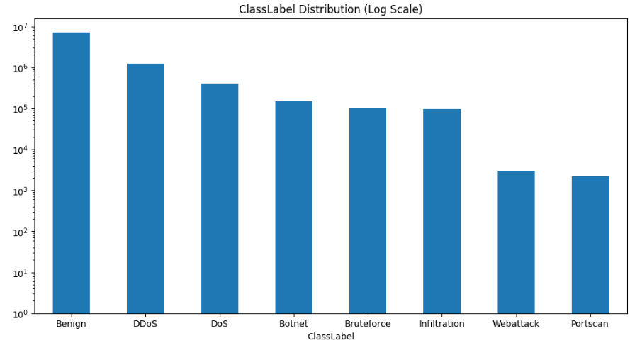

Slide 7
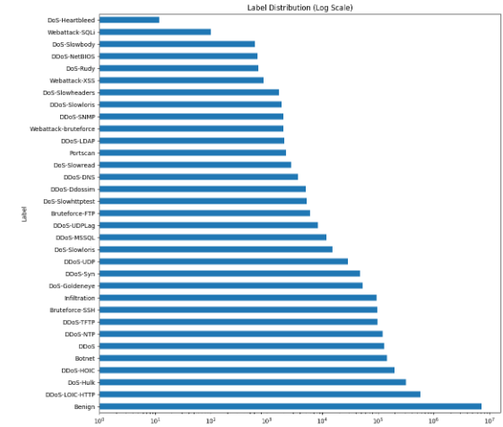

Slide 8
Outliers in the dataset
Among the 57 independent features: -
12 features have outliers whose percentage of difference between Malicious and Benign events is greater than or equal to 10%.
Remaining 45 features have nearly equal percentage of outliers labelled as Malicious and Benign.
Out of the 12 features, 4 features have relatively higher percentage of outliers.
Init Fwd Win Bytes: 39.24%
Init Bwd Win Bytes: 37.32%
Fwd Seg Size Min: 37.02%
Bwd IAT Mean: 14.04%

Slide 9
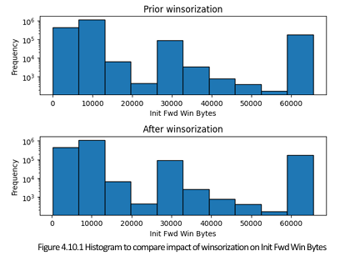
Impact of Winsorization on Init Fwd Win Bytes

Slide 10
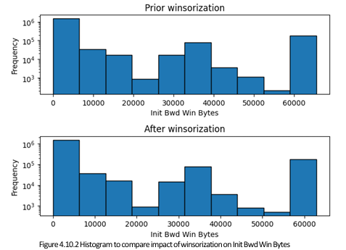
Impact of Winsorization on Init Bwd Win Bytes

Slide 11
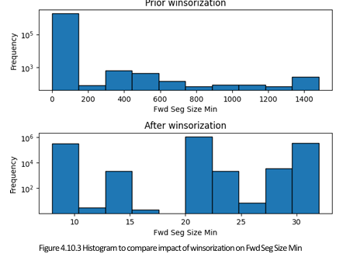
Impact of Winsorization on Fwd Seg Size Min

Slide 12
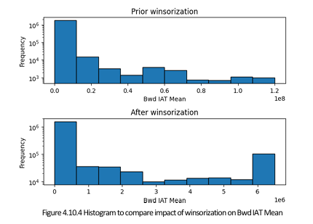
Impact of Winsorization on Bwd IAT Mean

Slide 13
Comparison of independent features prior and post handling of negative values and outliers

Slide 14
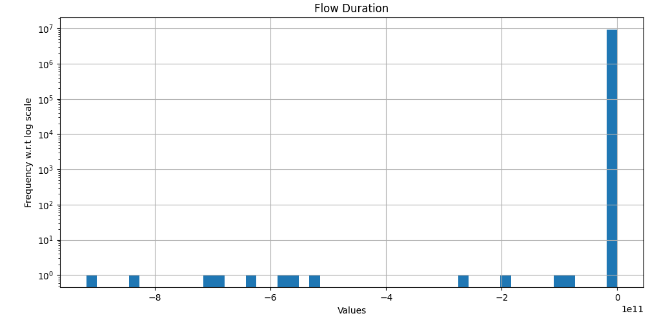
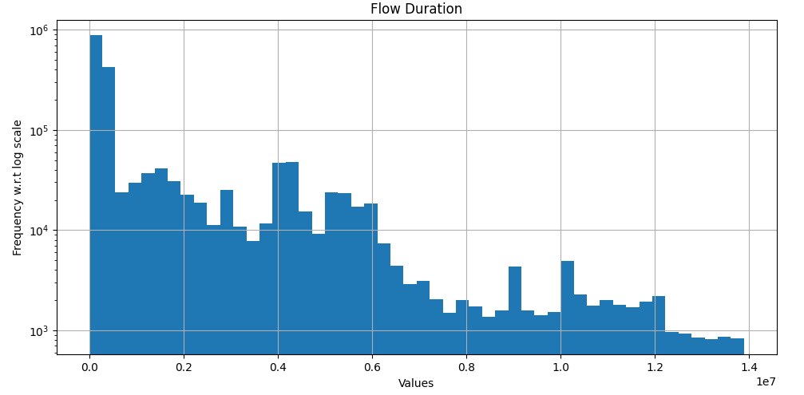
Flow Duration
At time period: t
Distribution of Flow Duration plotted using log scale
At time period: t+1
Distribution of Flow Duration after handling negative values and outliers plotted using log scale

Slide 15
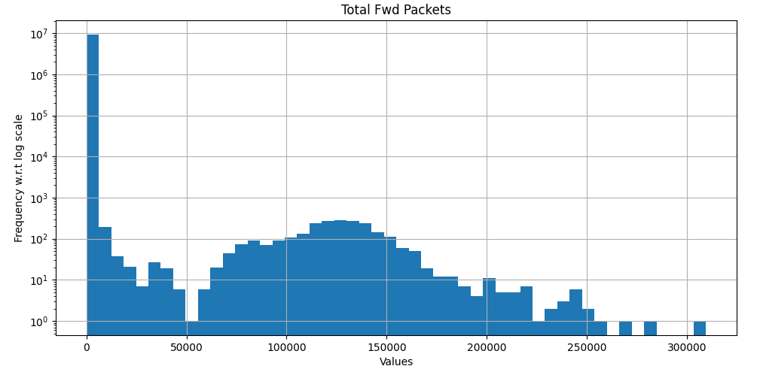
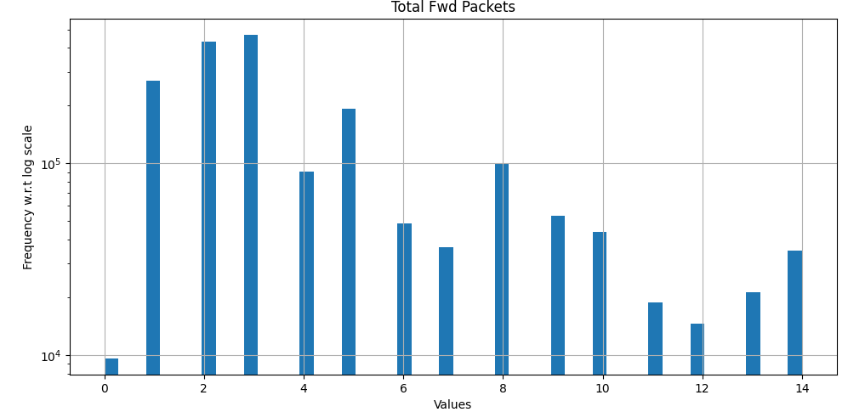
Total Fwd Packets
At time period: t
Distribution of Total Fwd Packets plotted using log scale
At time period: t+1
Distribution of Total Fwd Packets after handling negative values and outliers plotted using log scale

Slide 16
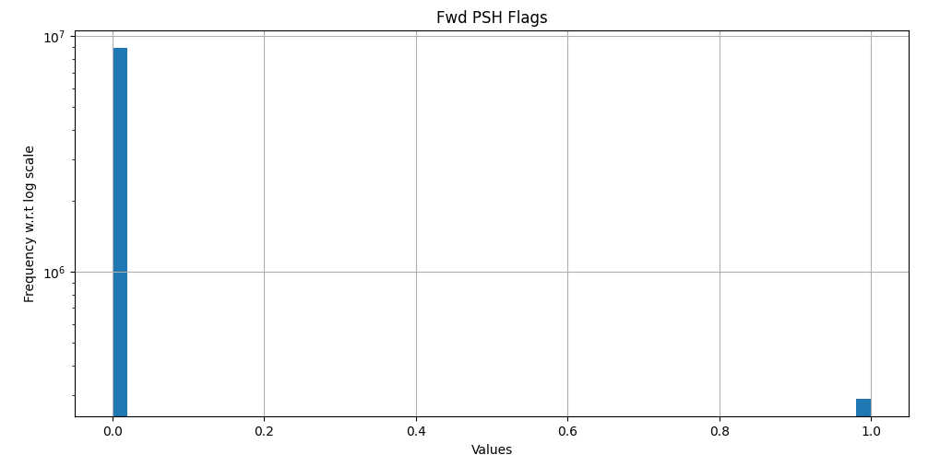
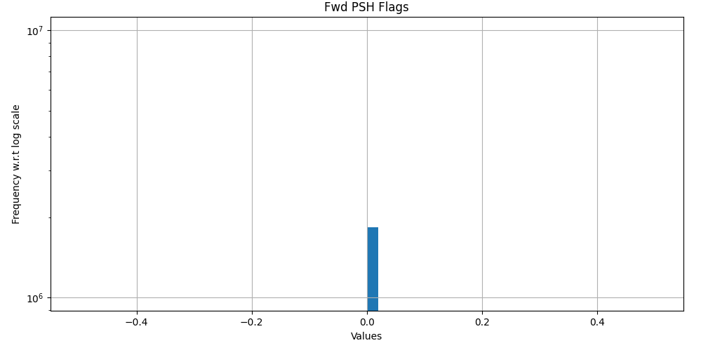
Fwd PSH Flags
At time period: t
Distribution of Fwd PSH Flags plotted using log scale
At time period: t+1
Distribution of Fwd PSH Flags after handling negative values and outliers plotted using log scale

Slide 17
Different methods to compute number of bins
Sturge’s rule
Doane’s rule
Rice rule
Square root rule
Scott’s rule
Knuth’s rule
Freedman-Diaconis rule

Slide 18
Sturge’s rule
Number of bins=⌈log2n + 1⌉
Where: -
n=Total number of observations in the dataset
⌈ ⌉=Ceiling operation, rounding the answer up to nearest integer
It depends only on size of the dataset.
It assumes normal distribution of dataset and does not work well on skewed dataset.

Slide 19

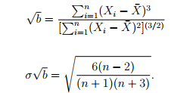
Doane’s rule
It is a modified version of Struge’s rule.
Number of bins=
Where: -
It has a correction term related to skewness of the distribution and works better on non-normally distributed data.
It can lead to over-smoothing, because Doane’s rule tends to recommend fewer bins when skewness of data is high. It can hide important details about the data distribution.

Slide 20
Rice rule
Number of bins= ⌈2 * ³√n⌉
Where: -
n=Total number of observations in the dataset
⌈ ⌉=Ceiling operation, rounding the answer up to nearest integer
It depends only on size of the dataset.
It works well on normal distribution and not on skewed distribution.

Slide 21
Square root rule
Number of bins = ⌈√n⌉
Where: -
n=Total number of observations in the dataset
⌈ ⌉=Ceiling operation, rounding the answer up to nearest integer
It depends only on size of the dataset.
It works well on normal distribution and not on skewed distribution.

Slide 22
Scott’s rule
Number of bins=
It depends on two parameters: -
Standard deviation: It is proportional to estimate of standard deviation.
Sample size: It is inversely proportional to the cube root of the sample size.
It works well on random samples of normally distributed dataset.

Slide 23
Knuth’s rule
It is a fixed width Bayesian approach to determine the optimal bin width of a histogram.
It is a Bayesian optimal bin estimator.
It works well on skewed, heavy-tailed and multi-modal distributions.

Slide 24
Freedman-Diaconis rule
Number of bins=(2*IQR) / ³√n
Where: -
n=Total number of observations in the dataset
IQR=Inter quartile range of the dataset.
Since it uses inter quartile range, it is more robust against outliers and better suited for skewed distribution of data.
With help of IQR, it adapts to spread and density of the dataset.
It can result in increased number of bins, but can also help to provide more information about the distribution.

Slide 25
Pyramid charts plotted for independent features w.r.t isMalicious

Slide 26
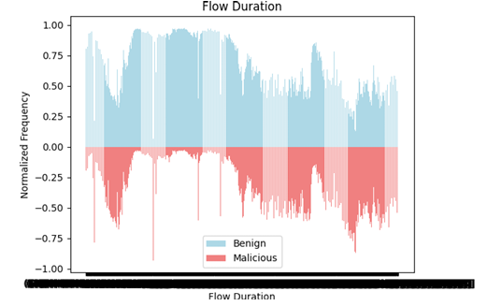
Flow Duration

Slide 27
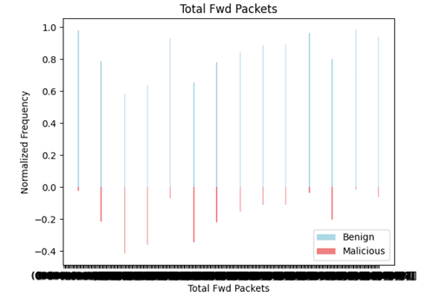
Total Fwd Packets

Slide 28
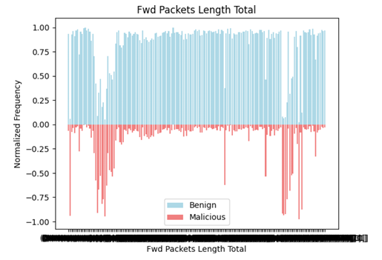
Fwd Packets Length Total

Slide 29
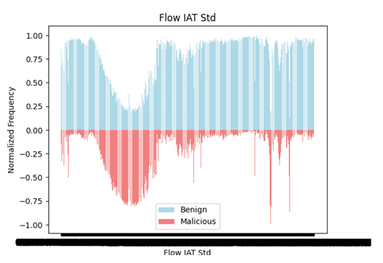
Flow IAT Std

Slide 30
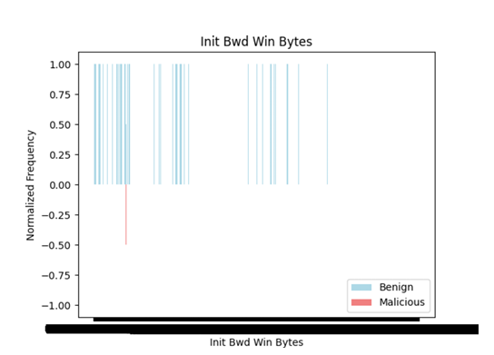
Init Bwd Win Bytes

Slide 31
Observations from Pyramid charts
Following features have almost equal number of Malicious and Benign records in most of the bins: -
Flow Duration
Flow IAT Max
Fwd Header Length
Following features have some bins where number of Malicious records are relatively more than the number of Benign records and thus, change in patterns were observed over a set of bins: -
Flow Bytes/s
Flow Packets/s
Flow IAT Std
Fwd IAT Max
Bwd IAT Std
Bwd IAT Max
Fwd Packets/s
Bwd Packets/s
‘Init Bwd Win Bytes’ was a rare feature which had only 1 bin with Malicious records and rest all bins had Benign records.
Remaining all features have relatively very high number of Benign records compared to Malicious records in most of the bins.

Slide 32
Analysis of features using descriptive statistics
Features with equal minimum and Q1 value
15 features
25% of datapoints in 15 features have value = 0.
Features with equal Q1 and Q3 value
2 features
50% of datapoints in 2 features have value.
Features have low variability and many constant values.
Features with equal Q3 and maximum value
0 features
All features in the upper range have high variability.

Slide 33
Some of the Heuristic algorithms that can be used for feature selection
Particle Swarm Optimization
Artificial Immune System
Artificial Bee Colony Optimization

Slide 34
Classification algorithms
Logistic Regression
Support Vector Machines
Decision Trees
Random Forest
Naïve Bayes
K-Nearest Neighbors

Slide 35
Evaluation metrics for classification models
Confusion matrix
Accuracy
Precision
Recall
F1-Score
ROC curve
AUC score
Balanced accuracy
Matthews Correlation Coefficient (MCC)
Negative predicted value
False discovery rate
*Cohen Kappa metric
Precision – Recall curve
* Cohen Kappa metric computation is explained in the next slides, however in the report only the final result is shared.

Slide 36
Cohen’s Kappa coefficient
k=Po-Pe/1-Pe
Example: - 20 events, 16 are benign and 4 are malicious
Classifier A is the ideal classifier, and thus, it correctly classifies each event.
Let us consider 4 cases for Classifier B: -
Case 1: All 20 events are classified as benign.
Case 2: All 20 events are classified as malicious.
Case 3: 3 benign events are incorrectly classified as malicious.
Case 4: 2 malicious events are incorrectly classified as benign.

Slide 37
Case 1
Classifier A and B have agreed on 16 events.
Classifier A and B have disagreed on 4 events.
Po=16/20 = 0.8
Number of times classifier A classifies events as Benign = 16 -> 80%
Number of times classifier A classifies events as Malicious = 4 -> 20%
Number of times classifier B classifies events as Benign = 20 -> 100%
Number of times classifier B classifies events as Malicious = 0 -> 0%
Pe=(0.80*1) + (0.20*0) = 0.8
k=0.8-0.8/1-0.8 = 0

Slide 38
Case 2
Classifier A and B have agreed on 4 events.
Classifier A and B have disagreed on 16 events.
Po=4/20 = 0.2
Number of times classifier A classifies events as Benign = 16 -> 80%
Number of times classifier A classifies events as Malicious = 4 -> 20%
Number of times classifier B classifies events as Benign = 0 -> 0%
Number of times classifier B classifies events as Malicious = 20 -> 100%
Pe=(0.80*0) + (0.20*1) = 0.2
k=0.2-0.2/1-0.2 = 0

Slide 39
Case 3
Classifier A and B have agreed on 17 events.
Classifier A and B have disagreed on 3 events.
Po=17/20 = 0.85
Number of times classifier A classifies events as Benign = 16 -> 80%
Number of times classifier A classifies events as Malicious = 4 -> 20%
Number of times classifier B classifies events as Benign = 13 -> 65%
Number of times classifier B classifies events as Malicious = 7 -> 35%
Pe=(0.80*0.65) + (0.20*0.35) = 0.59
k=0.85-0.59/1-0.59 = 0.63

Slide 40
Case 4
Classifier A and B have agreed on 18 events.
Classifier A and B have disagreed on 2 events.
Po=18/20 = 0.9
Number of times classifier A classifies events as Benign = 16 -> 80%
Number of times classifier A classifies events as Malicious = 4 -> 20%
Number of times classifier B classifies events as Benign = 18 -> 90%
Number of times classifier B classifies events as Malicious = 2 -> 10%
Pe=(0.80*0.90) + (0.20*0.10) = 0.74
k=0.90-0.74/1-0.74 = 0.615

Slide 41
Comparison of Case 3 and Case 4
Case 3: All 4 malicious events were correctly classified, 3 out of 16 benign events were misclassified.
Case 4: - 2 out of 4 malicious events were misclassified, all 16 benign events were correctly classified.
False positive = 3
Number of disagreements = 3
Cohen’s Kappa score = 0.63
False negative = 2
Number of disagreements = 2
Cohen’s Kappa score = 0.615
Interpretation: - Since the number of benign events is greater than number of malicious events
In Case 3: Correct classification of all 4 malicious events holds more importance than misclassification of 3 benign events. As the result, Cohen’s Kappa score is greater than case 4.
In Case 4: - Misclassification of 2 out of 4 malicious events holds more importance than correct classification of all 16 benign events. As the result, Cohen’s Kappa score is smaller than case 3.
Although both case 3 and 4 have significant difference in classification of malicious events, the scores are quite close to each other and also fall under same range of interpretation.

Slide 42
Directions for future work after mid semester
Working on imbalanced nature of the dataset.
Standardization of independent features.
Selection of classification algorithms
Implementation of feature selection using heuristic algorithms
Training the classifier models
Evaluation of models
Documentation of results

